Slide 1
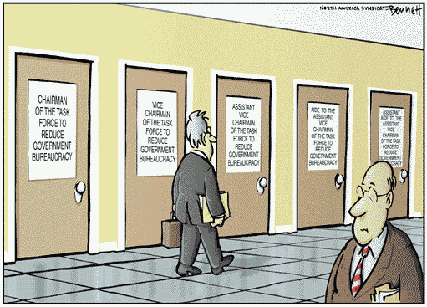
Bureaucratic Interactions: The Branches other members of Government

Slide 2
The Legislative Branch (Congress) and the Bureaucracy
creates, reorganizes, and eliminates agencies (sometimes with Presidential input)
controls funds (appropriates money) for bureaucratic departments and agencies
executive agencies report to committees- committees work with bureaucracy for mutual support and favorable outcomes
gives jobs to different agencies- prevent single agency from being too powerful
holds hearings on agency abuses; impeaches “higher-ups”
writes legislation to restrict power/give power to an agency/department

Slide 3
The Executive Branch (The President) and the Bureaucracy
appoints senior bureaucrats – Cabinet secretaries, agency heads, etc…
issues executive orders that must be obeyed; directs agencies to carry out specific actions/goals.
controls agency’s budget through Office of Management and Budget (OMB). The OMB may cut or add to the budget of a particular agency. Congress provides the appropriations ($$$).
administrative reform- may combine/ reorganize agencies based on “need” (approval of Congress needed). May be subject to national emergency or crisis. Example- Department of Homeland Security.
presidential control has fluctuated over the years as not all presidents have the same interest in exercising executive leadership over the bureaucracy.

Slide 4
The Judicial Branch (Supreme Court) and the Bureaucracy
Role of the Supreme Court began in 1876…
Munn v. Illinois: Supreme Court upheld Granger laws, establishing constitutional principle of public regulation of private businesses involved in serving public interest.
Progressive Era also increased regulation of business & gov’t entities.
What if an agency is not upholding its responsibilities?
Massachusetts v. EPA (2008) the role of the EPA in regard to regulating greenhouse gases and global warming. Ten states petitioned the EPA to regulate carbon dioxide emissions. The EPA consistently rejected putting caps on emissions.
Ruling: In 5-4 decision, EPA was responsible to issue emission standards for automobiles under Clean Air Act because greenhouse gases are “air pollutant agents”.
Hence, the Supreme Court has a role in determining agency responsibilities.

Slide 5
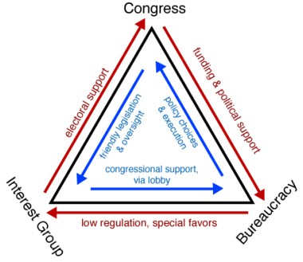
The Iron Triangle: What is it?
• The term used by political scientists to describe the policy-making relationship between Congress (committees), the bureaucracy, and interest groups.
The Result: an alliance sometimes called a “sub government” because of its durability and power to determine policy.
Assumptions:
Bureaucratic agencies, as political entities, seek to create and consolidate their own power base. Hence, the power of an agency is determined by its constituency, not by its consumers.
By aligning itself with selected constituencies, an agency may affect policy outcomes.

Slide 6
Iron Triangle: The Three Corners
Interest Groups: Interest groups often attempt to influence Congressional votes in their favor and can sufficiently influence the re-election of a member of Congress in return for supporting their programs.
Congress: Members of Congress align themselves with a constituency for political and electoral support. Often times, in turn, these congressional members support legislation that advances the interest group's agenda.
The Bureaucracy: Bureaucrats are often pressured by powerful interest groups that their agency is designated to regulate.

Slide 7
Issue Networks
An “issue network” is an alliance of various interest groups and individuals who unite to promote a single issue in gov’t policy. They push for a change in policy within the government bureaucracy.
Example: network of environmental groups and individuals who push for more environmental regulation in government policy.
Who makes up an issue network? political executives, career bureaucrats, management/policy consultants, academic researchers, universities, journalists, members of the media, White House aides, etc…

Slide 8
Differences Between Iron Triangles and Issue Networks
Iron triangles are mutually beneficial relationships between interest groups, private businesses and corporations, congressional oversight committees, and federal agencies.
Iron Triangle relationships seek only to benefit those involved at the expense of the constituencies that Congress and the Federal bureaucracy are supposed to represent, the general public.

